Slide 1
Building Android apps – Week 9b
2843-201710_MCS4993_M:Topics in MA/CS
2843-201710_MCS5993_M:Topics in Computer Science
Notes:
SHOW EACH OF THE TOOLS
SHOW EMULATOR REAL QUICK – advanced settings

Slide 2
Agenda
Under the hood
SDK tools
Android Security
Developer Console

Slide 3
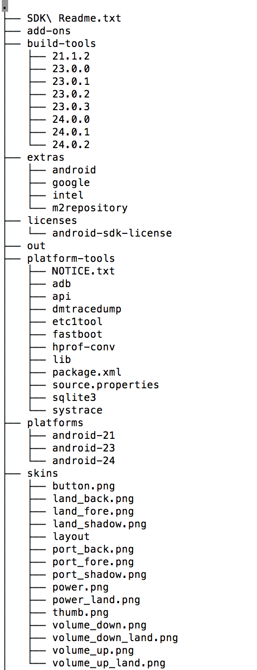
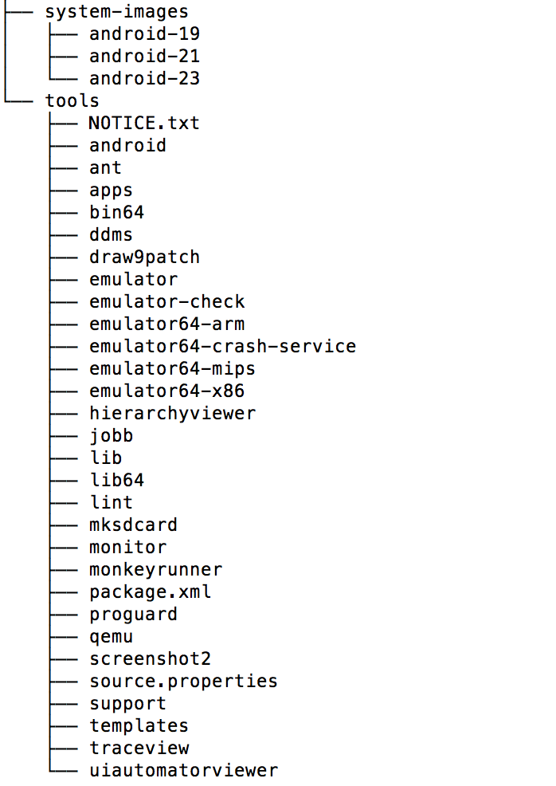
Notes:
Let’s take a look at the tools in the SDK

Slide 4
Virtual Device Tools
Android Virtual Device Manager
Android Emulator
mksdcard
Notes:
Virtual Device Tools
Android Virtual Device ManagerThe AVD Manager provides a graphical user interface in which you can create and manage Android Virtual Devices (AVDs) that run in the Android Emulator.
Android Emulator (emulator)A QEMU-based device-emulation tool that you can use to debug and test your applications in an actual Android run-time environment.
mksdcardHelps you create a disk image that you can use with the emulator, to simulate the presence of an external storage card (such as an SD card).

Slide 5
Development Tools
Hierarchy Viewer
SDK Manager
sqlite3
Notes:
Development Tools
Hierarchy Viewer (hierarchyviewer)Provides a visual representation of the layout's View hierarchy with performance information for each node in the layout, and a magnified view of the display to closely examine the pixels in your layout.SDK ManagerLets you manage SDK packages, such as installed platforms and system images.sqlite3Lets you access the SQLite data files created and used by Android applications.

Slide 6
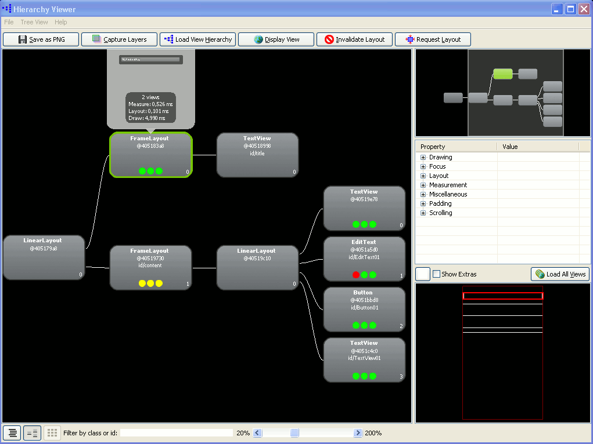

Slide 7
Debugging Tools
Android Monitor
adb
Dalvik Debug Monitor Server (ddms)
Systrace
traceview
Tracer for OpenGL ES
Notes:
Debugging Tools
Android MonitorAndroid Monitor is integrated into Android Studio and provides logcat, memory, CPU, GPU, and network monitors for app debugging and analysis.
adbAndroid Debug Bridge (adb) is a versatile command line tool that lets you communicate with an emulator instance or connected Android-powered device. It also provides access to the device shell.
ADB Shell CommandsLearn the commands available for advanced command-line operations.
Dalvik Debug Monitor Server (ddms)Lets you debug Android apps.
Device MonitorAndroid Device Monitor is a stand-alone tool that provides a graphical user interface for several Android application debugging and analysis tools.
SystraceLets you analyze the execution of your application in the context of system processes, to help diagnose display and performance issues.
traceviewProvides a graphical viewer for execution logs saved by your application.
Tracer for OpenGL ESAllows you to capture
OpenGL ES commands and frame-by-frame images to help you understand how your app is executing graphics commands.

Slide 8
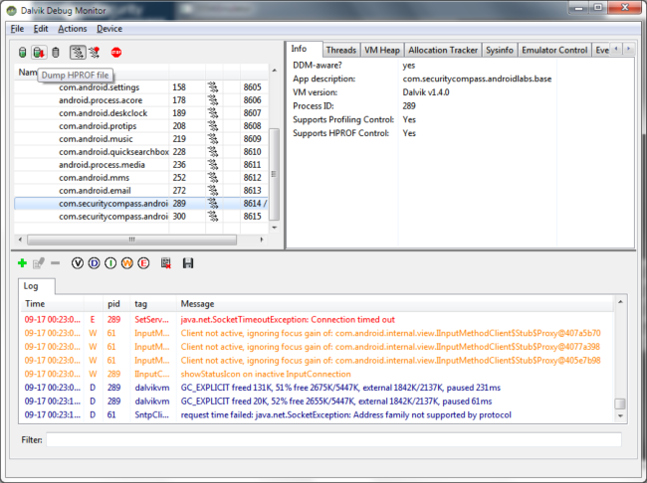

Slide 9
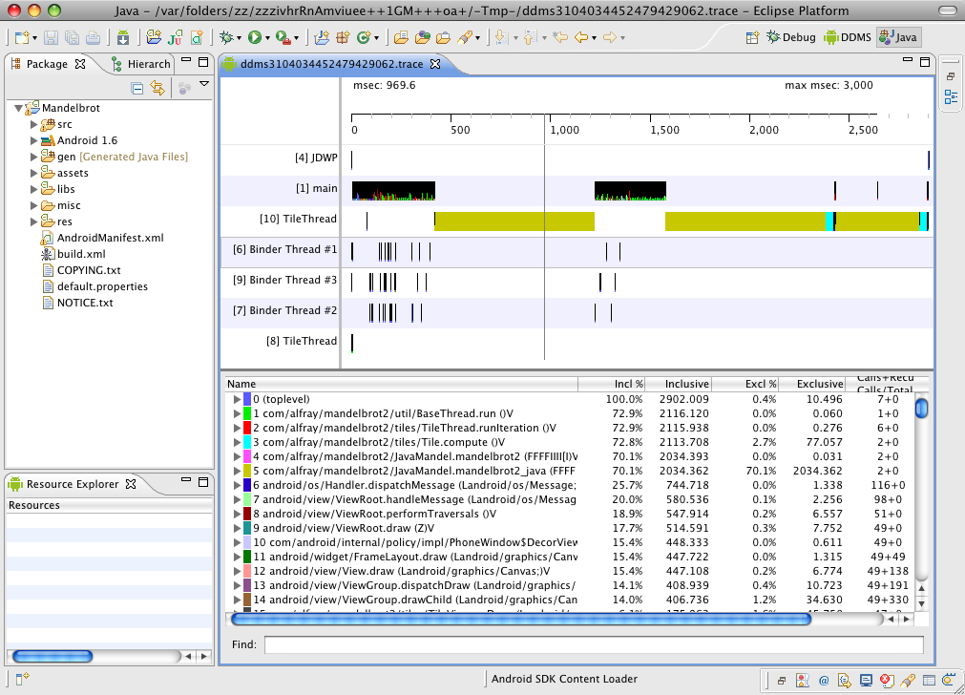

Slide 10
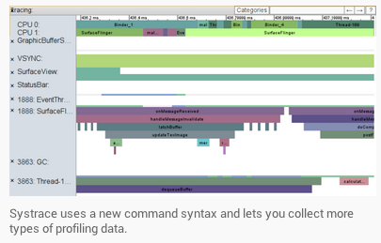

Slide 11
Build Tools
apksigner
JOBB
ProGuard
zipalign
Notes:
Build Tools
apksignerSigns APKs and checks whether APK signatures will be verified successfully on all platform versions that a given APK supports.
JOBB Allows you to build encrypted and unencrypted
APK expansion files in Opaque Binary Blob (OBB) format.
ProGuardShrinks, optimizes, and obfuscates your code by removing unused code and renaming classes, fields, and methods with semantically obscure names.
zipalignOptimizes APK files by ensuring that all uncompressed data starts with a particular alignment relative to the start of the file

Slide 12
Image Tools
Draw 9-patch
etc1tool
Notes:
Image Tools
Draw 9-patchAllows you to easily create a NinePatch graphic using a WYSIWYG editor. It also previews stretched versions of the image, and highlights the area in which content is allowed.
etc1toolA command line utility that lets you encode PNG images to the ETC1 compression standard and decode ETC1 compressed images back to PNG.

Slide 13
Android Security
How did we get here
Virtual Machines
Static Information
Dynamic Information

Slide 14
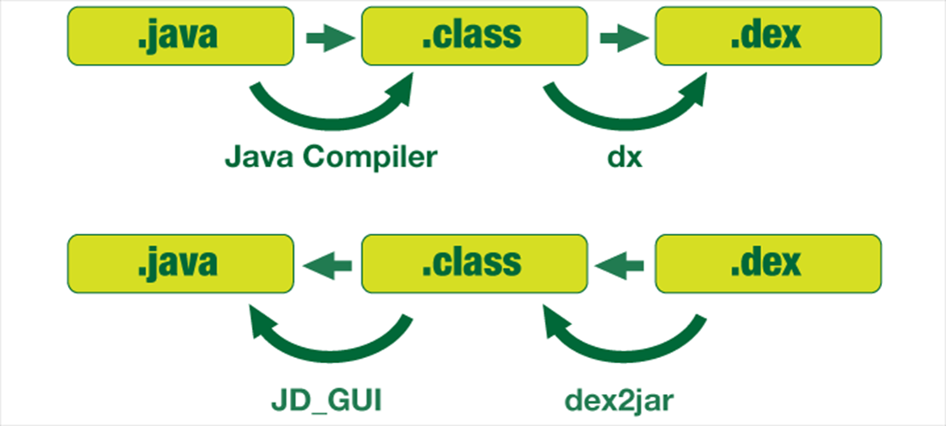
Decompilation 101

Slide 15
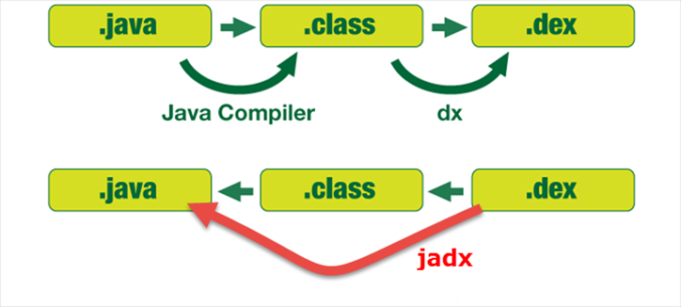
Decompilation 101

Slide 16
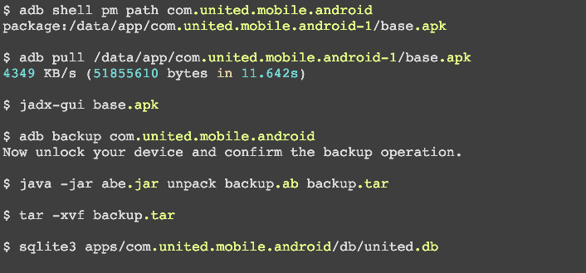
Decompilation 101

Slide 17
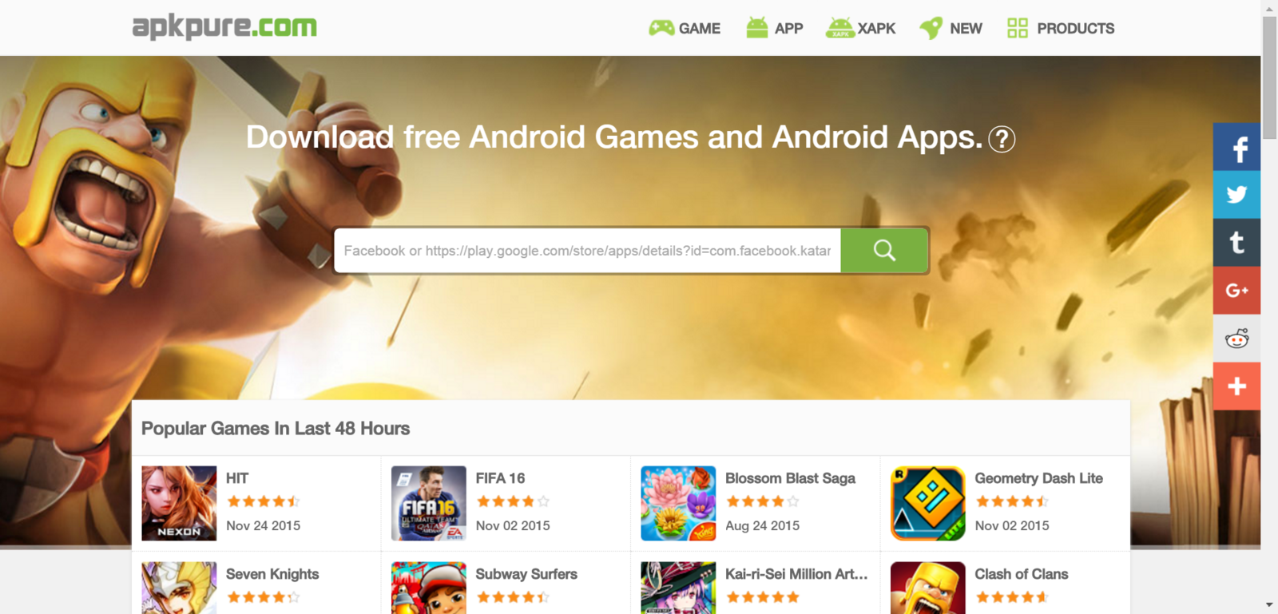
Decompilation 101

Slide 18
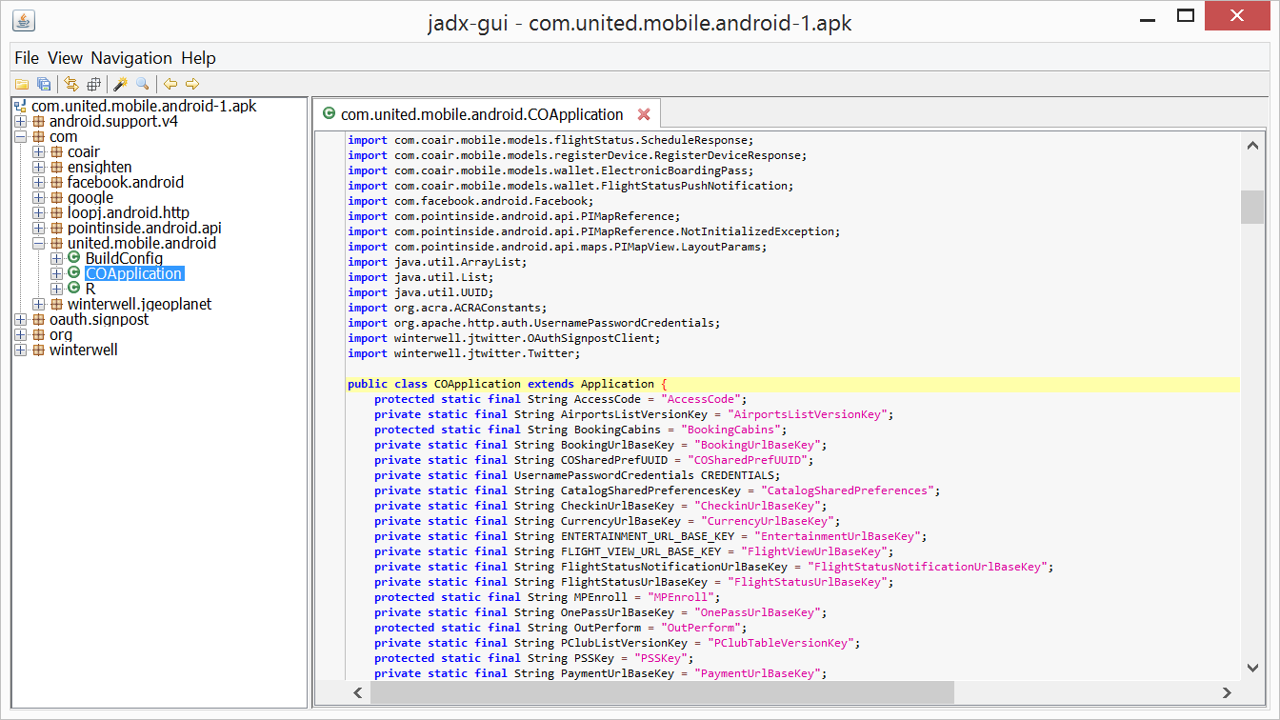
Decompilation 101

Slide 19
OWASP Mobile Top 10 Risks
Weak Server Side Controls
Insecure Data Storage
Insufficient Transport Layer Protection
Unintended Data Leakage
Poor Authorization and Authentication
Broken Cryptography
Client Side Injection
Security Decision via Untrusted Input
Improper Session Handling
Lack of Binary Protections
Notes:
Define problem for each area, show a real world example and then the fix

Slide 20
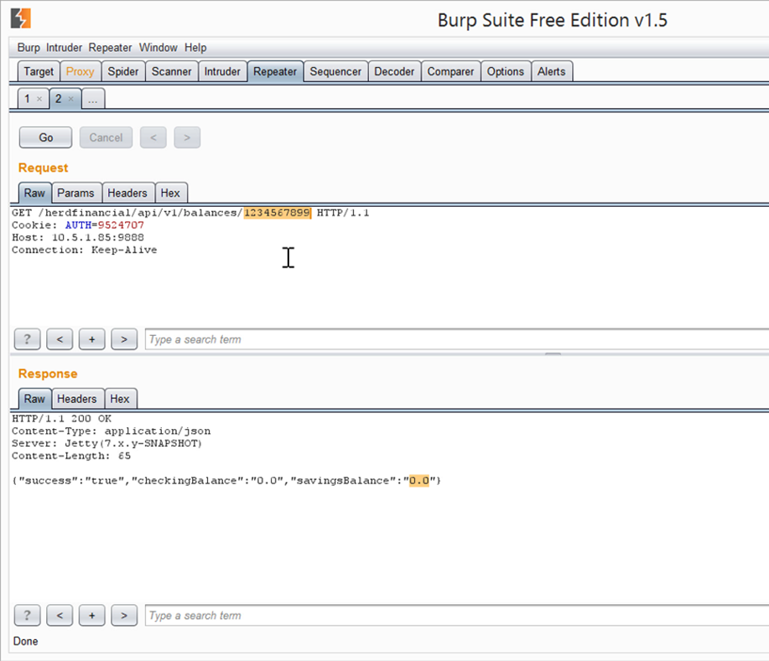
GET http://herdfinancial.com/api/v1/balances/1234567899
{“success”:”true”,”checkingBalance”:”0.0”,”savingsBalance”:”0.0”}

Slide 21
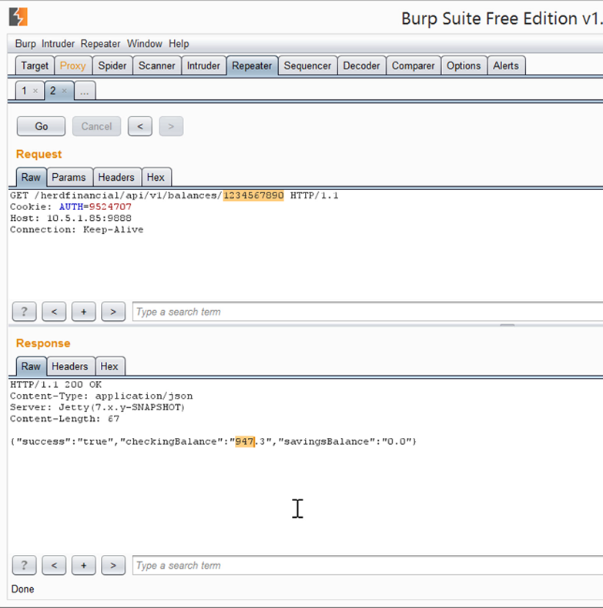
GET http://herdfinancial.com/api/v1/balances/1234567890
{“success”:”true”,”checkingBalance”:”947.3”,”savingsBalance”:”0.0”}

Slide 22
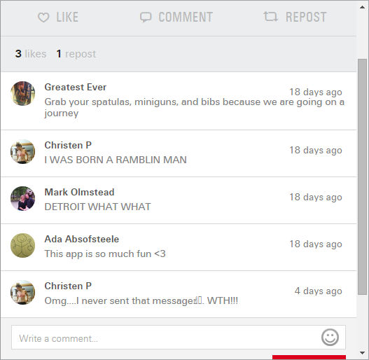

Slide 23
"actor": {“first_name": "Rita","last_name": "D.","title": "Rita D.","gender": "F",
"is_mvp": false,
"preferred_brand": 32,
"_links": {"self": [{"href": "\/v7.0\/user\/3273986\/","id": "3273986"}]},
"type": "user",
"friendship": null,
"id": 3273986},
"id": "1-3273986-9-1440092847",

Slide 24
Weak Server Side Fixes
Use GUID that maps to ID
REST verbs are easy to guess
OWASP Web/Cloud top 10
Don’t trust the client, verify

Slide 25
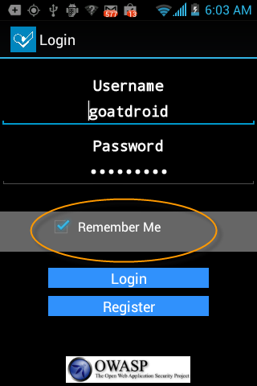
Insecure Data Storage

Slide 26
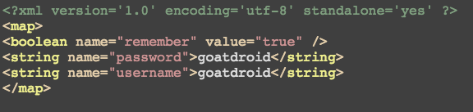
Insecure Data Storage

Slide 27
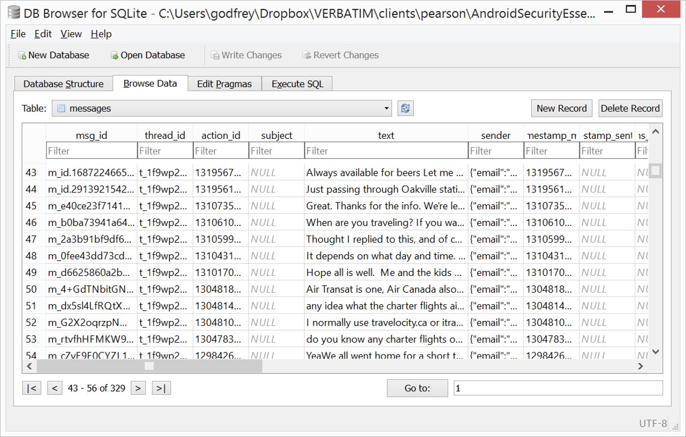
Insecure Data Storage
Notes:
Real world example

Slide 28
Insecure Data Storage
No caching of passwords, SSNs etc.
Multi-factor authentication
Client / Server side access control
"Sensitive data should be encrypted and very sensitive data should be stored on server" - Zapata

Slide 29
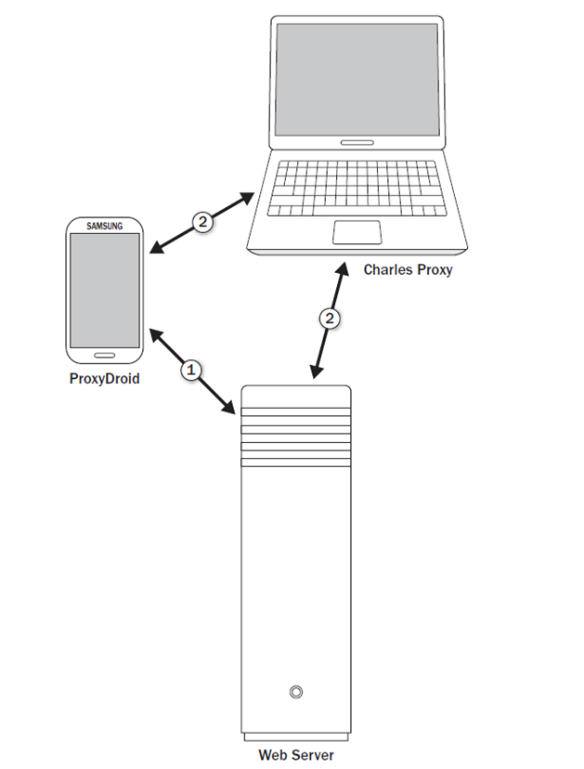
Insufficient TLS Protection

Slide 30
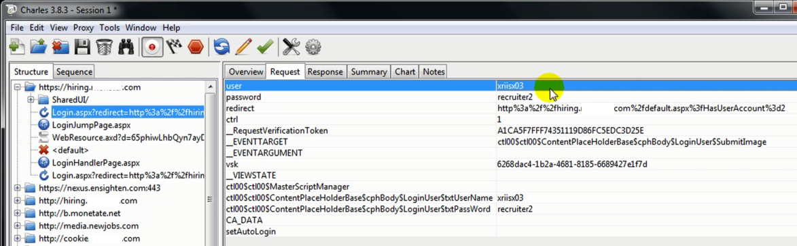
Insufficient TLS

Slide 31
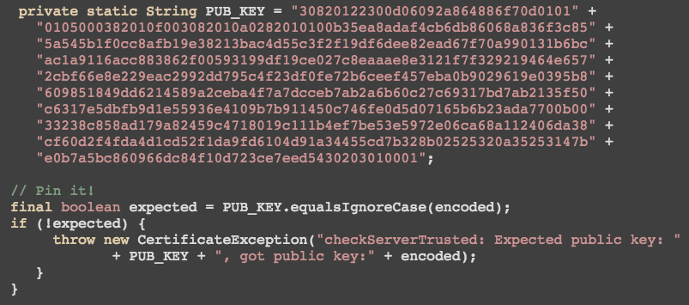
Insufficient TLS
Notes:
FIX – use SSL Pinning

Slide 32
Insufficient TLS protection
Error out on SSLHandshakeException
Assume SSL is broken, root level CA's
SSL pinning
Do more on the server
Scan server with nogotofail

Slide 33
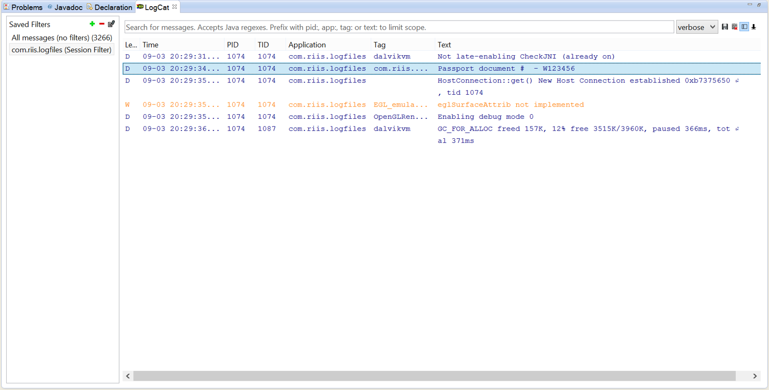
Unintended Data Leakage

Slide 34
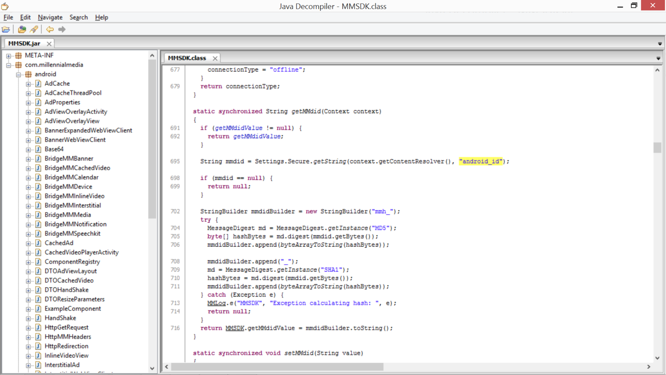
Notes:
Make sure any libraries you’re using don’t send back info back to the sdk company

Slide 35
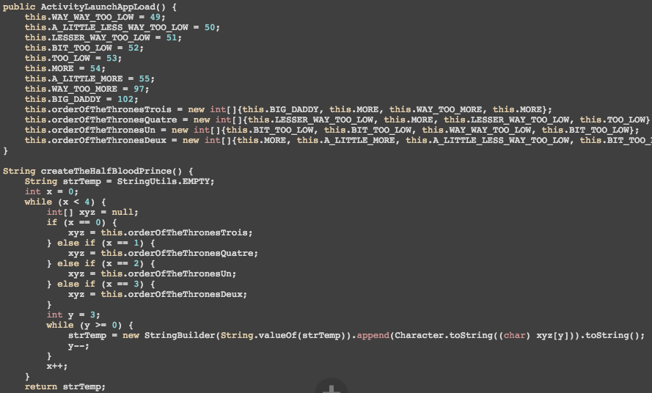
Notes:
Don’t’ be cute if you’re not going to use proguard, someone else can see your code

Slide 36
Unintended Data Leakage
Strip out unneccesary logging code
Obfuscate method names
Check any third party libraries
Double check your webview caches
Download and unzip your APK

Slide 37
Poor Authorization and Authentication

Slide 38
Poor Authorization and Authentication
No password caching
Multi Factor Authentication
Encryption
Oauth tokens
Use Server side one time id or nonce

Slide 39
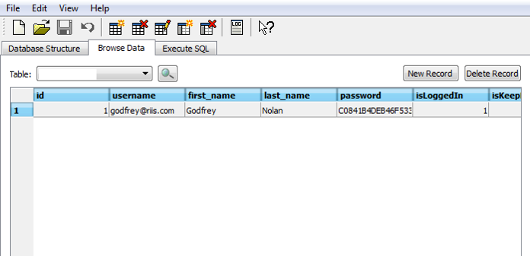
Broken Cryptography

Slide 40
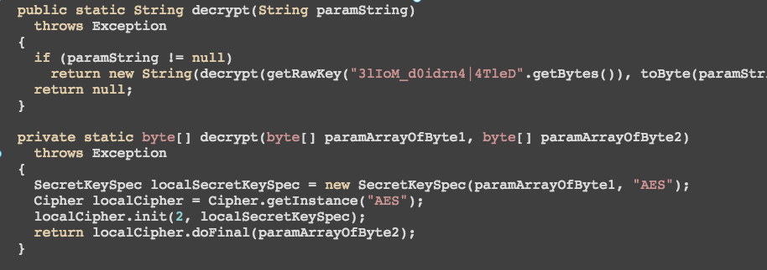
Broken Cryptography

Slide 41
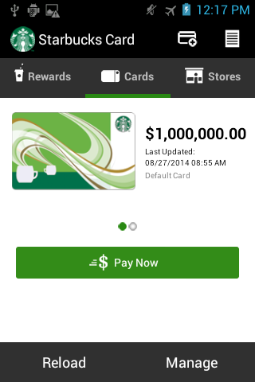
Broken Cryptography

Slide 42
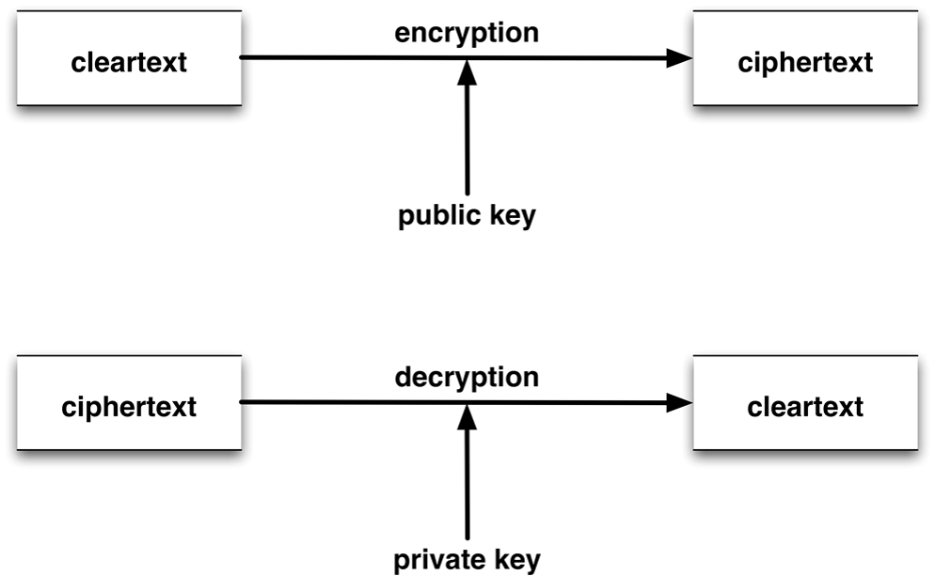
Broken Cryptography
Notes:
Never roll your own cryptography, use existing libraries such as Bouncy Castle

Slide 43
Broken Cryptography
Use asymmetric encryption
Encrypt databases
Assume Android Keystore is broken

Slide 44
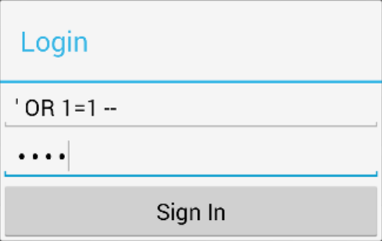
Client Side Injection

Slide 45
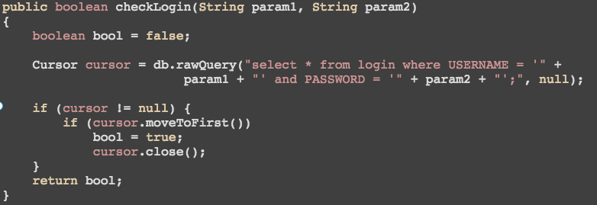
Client Side Injection

Slide 46
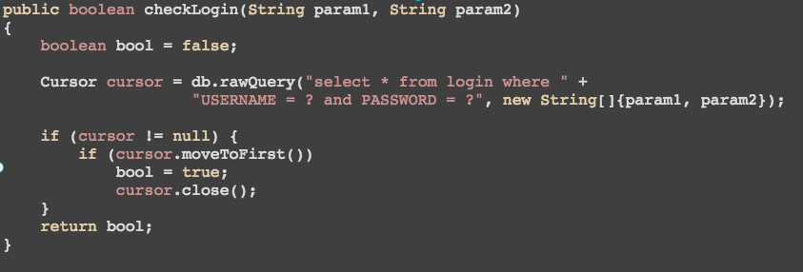
Client Side Injection

Slide 47
Client Side Injection
Use parameterized queries
setJavaScriptEnabled(false)

Slide 48
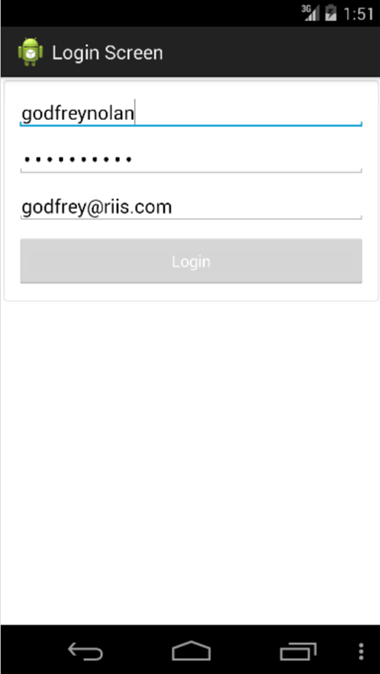
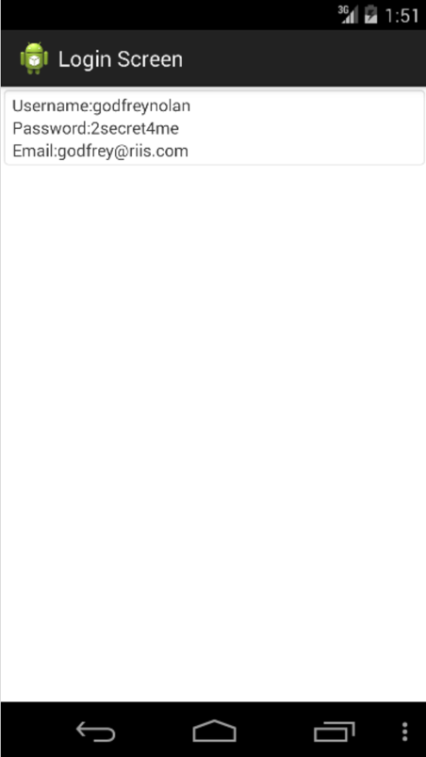
Security Decision via Untrusted Input

Slide 49
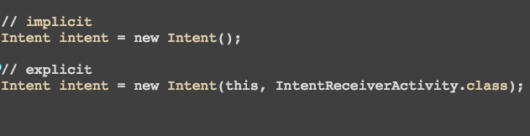
Untrusted Input
Notes:
Use Explicit Intents

Slide 50
Improper Session Handling
Session never times out
adb backup from one phone onto another

Slide 51
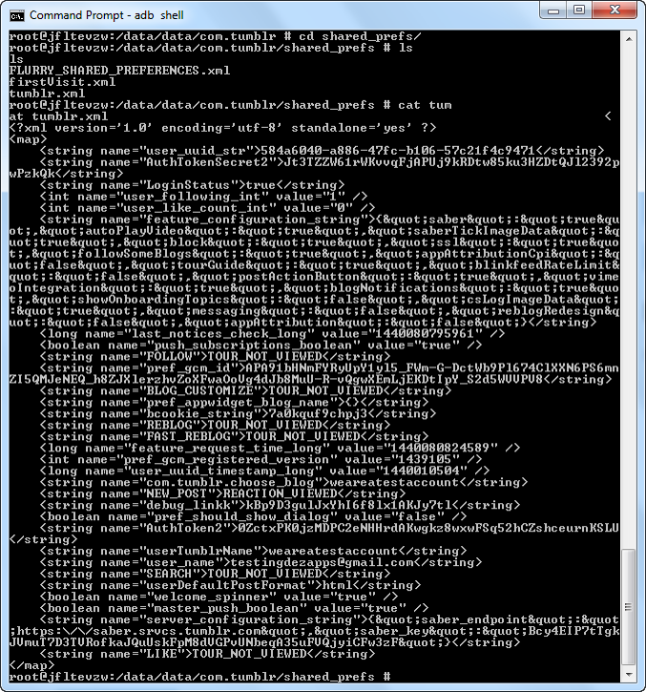
Notes:
Tumbler shared preferences

Slide 52
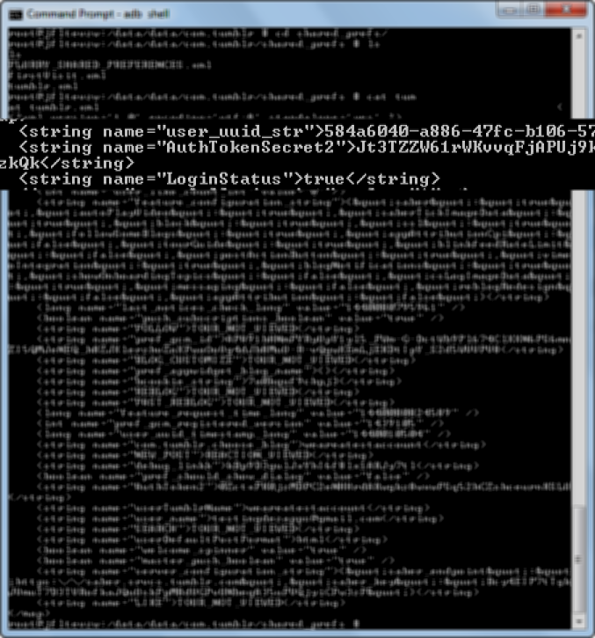

Slide 53
Improper Session Handling
Expire sessions
Try backup to another phone
Careful using OAuth logins to FB etc.

Slide 54
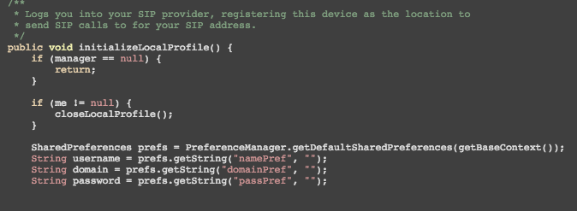
Lack of Binary Protections
Notes:
Using a sample google sample app for making VoIP phone calls – what is known as a SIP client
Let’s have a look at what happens when we compile it and decompile it

Slide 55
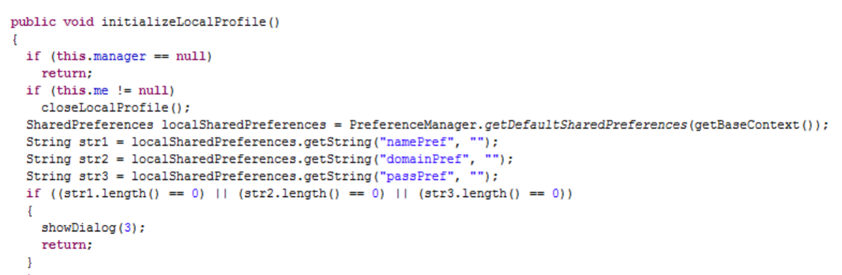
Lack of Binary Protections
Notes:
Compiled and then decompiled

Slide 56
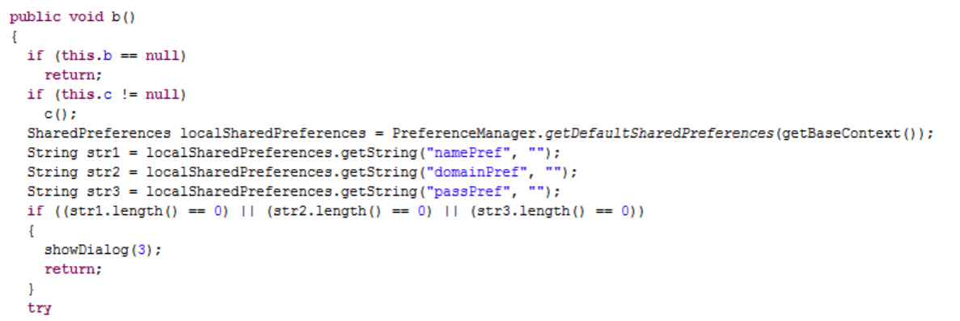
Lack of Binary Protections
Notes:
Using ProGuard

Slide 57
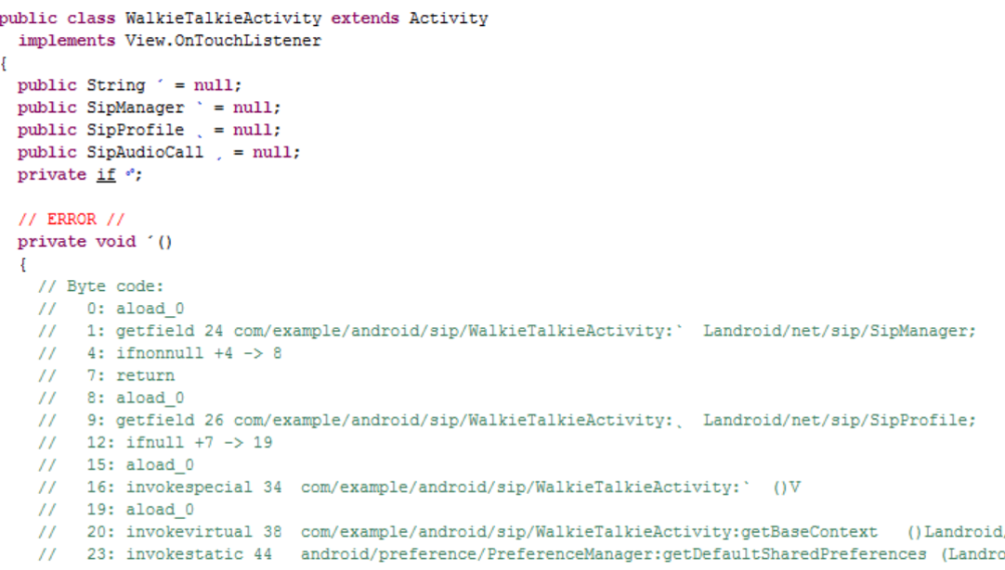
Lack of Binary Protections
Notes:
Using DexGuard

Slide 58
Lack of Binary Protections
Obfuscation helps remove useful info
Set minifyEnabled = true
Not a silver bullet
Anti ProGuard apps out there
Hackers just move to Smali
Code in C++ using NDK
Much harder to read
Can still disassemble C++

Slide 59
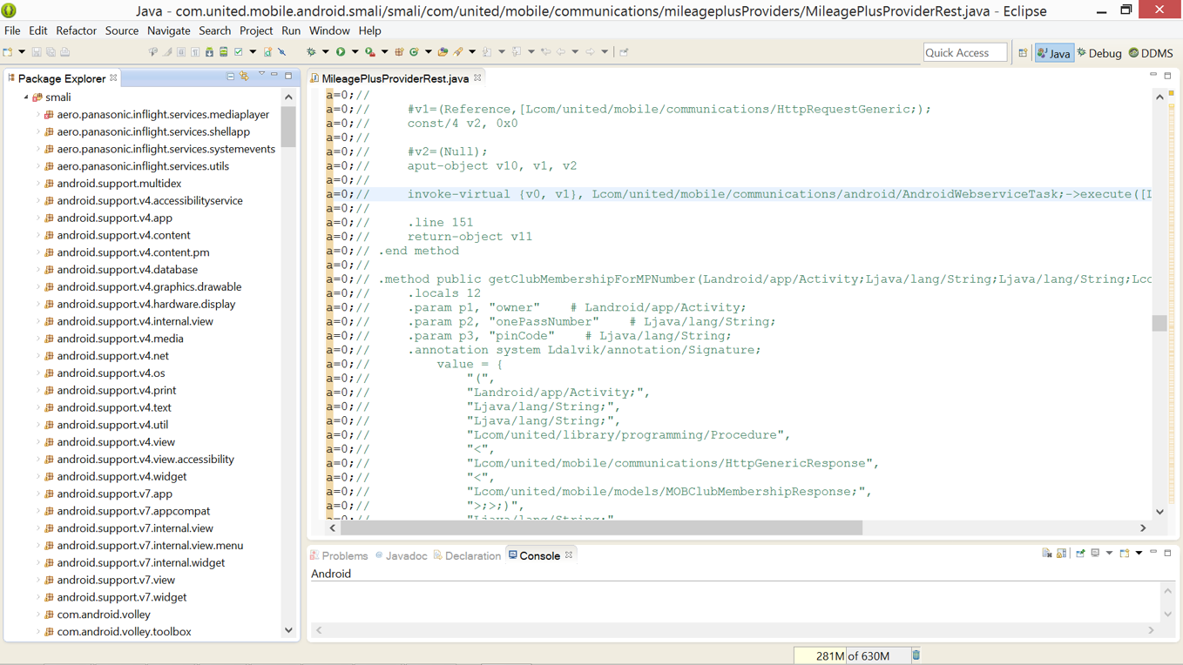

Slide 60
Developer Console
http://play.google.com/apps/publish
$25 credit card charge

Slide 61
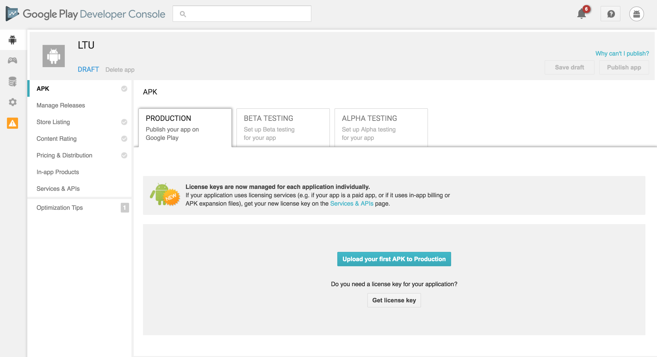

Slide 62
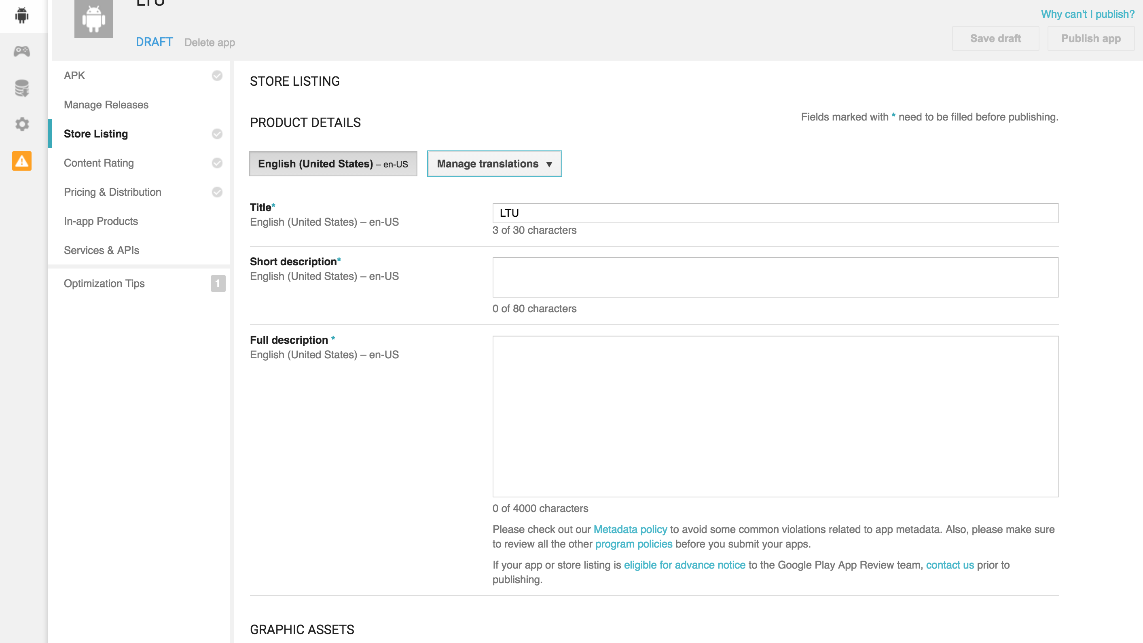

Slide 63
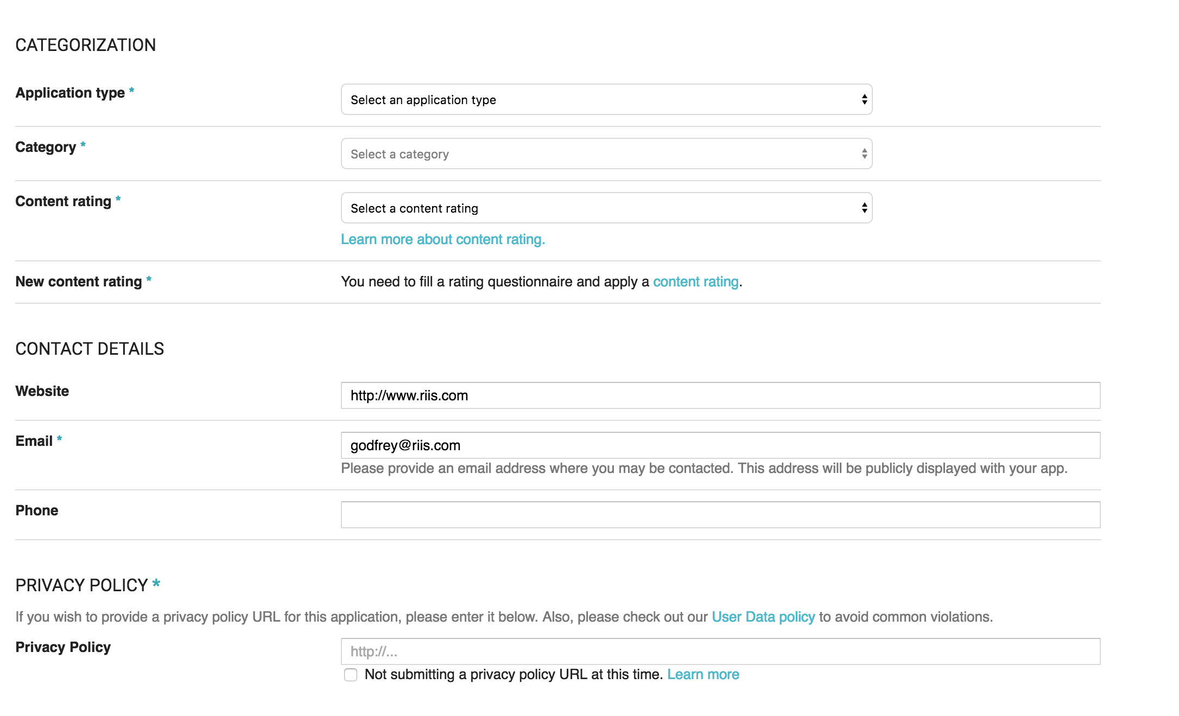

Slide 64
Tuesday
Material Design

